Slide 1


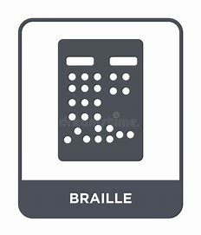
Firebirds
Multilingual conversion to
BRAILLE

Slide 2

Table of
CONTENTS
01
02
03
04
Team members
Mission Statement
Proposed Objectives
Main Services
05
06
07
08
Project Architecture
Statistical analysis
Various Uses
Improvements
and Conclusion

Slide 3
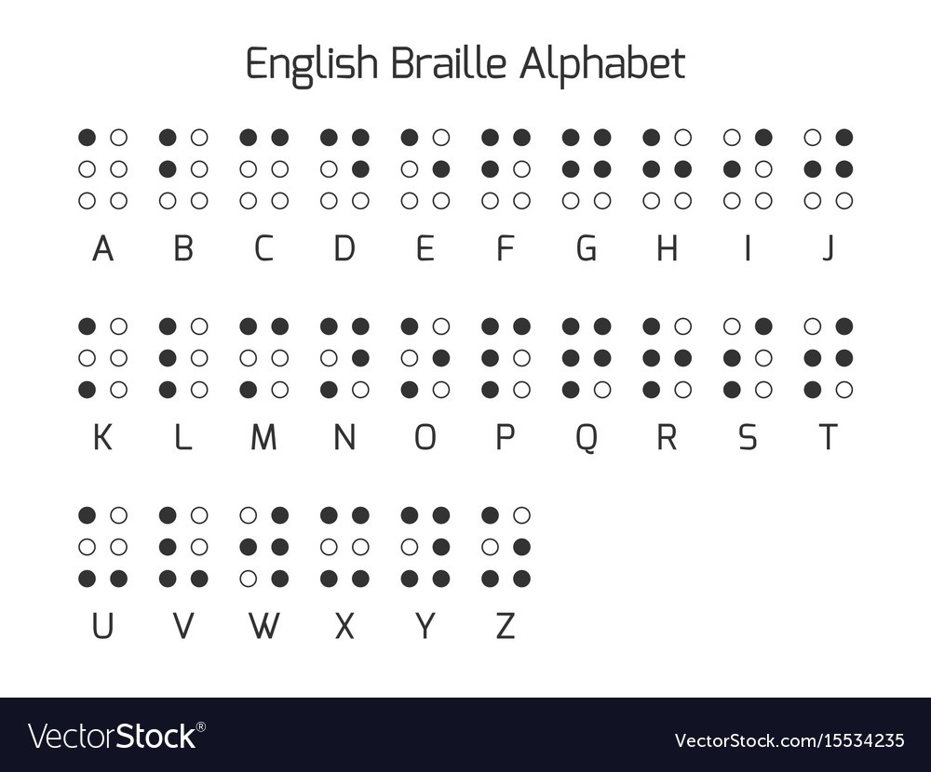
TEAM MEMBERS :
PRANAVI .K
POORANI .B
PRIYADHARSHINI .R
SHANGEETHA .S
SALOMI OLI ARASI .C
YAKHSHA RATTHA .P
-3RD YR IT B
MENTOR :
MRS.T.MANJU

Slide 4

Mission Statement
In this project, we convert a speech or text input into Braille text and audio file of the required language which is selected by the user.

Slide 5

Objective 1
Proposed
The Input Audio is Converted to the Text and Braille Characters using Amazon Transcribe. Example: Tamil Audio is converted to Tamil Text and Braille.
OBJECTIVES
Objective 2
The Given Project is done using AWS Software Development Kit in Python or AWS Python SDK. The Services used here are Amazon Simple Storage Service(Amazon S3), Amazon Transcribe and Amazon Translate.
The Given Texts are converted to other Languages using Amazon Translate. Example: In this case, we convert the texts to Hindi and English.
Objective 3
The Texts are converted to their respective Braille Characters and Audio Files using Google Translate’s Text to Speech API (gTTS).

Slide 6

THE MAIN SERVICES
01
Amazon Transcribe
02
Amazon Translate
Amazon Transcribe is an automatic speech recognition (ASR) service that makes it easy for developers to add speech to text capability to their applications.
Amazon Translate is a neural machine translation service that delivers fast, high-quality, affordable, and customizable language translation.
03
Amazon S3
04
gTTS
Amazon Simple Storage Service (Amazon S3) is an object storage service that offers industry-leading scalability, data availability, security, and performance.
gTTS (Google Text-to-Speech), a Python library and CLI tool to interface with Google Translate's text-to-speech API. Write spoken mp3 data to a file, and vice versa etc.

Slide 7
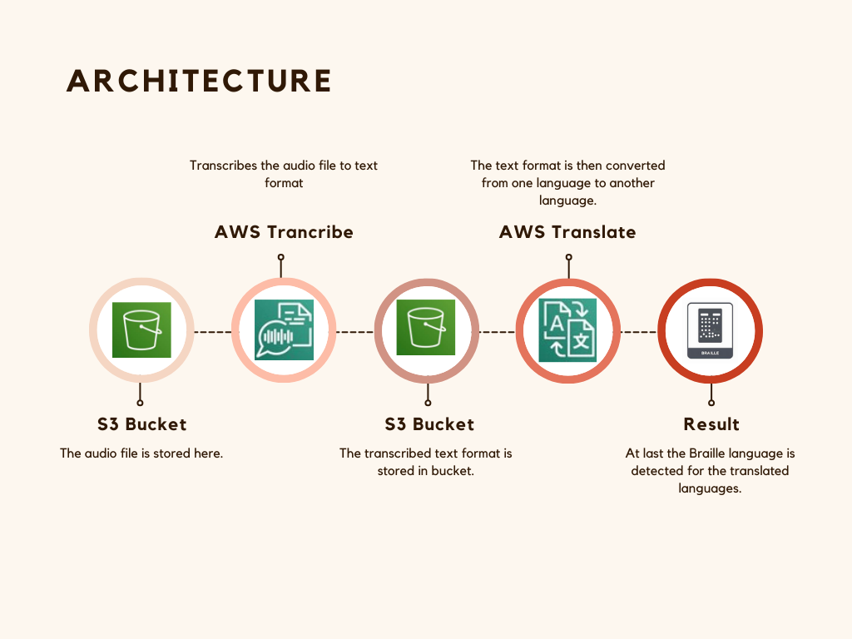

Slide 8
Statistical analysis
Currently, there are an estimated 4.95 million blind persons and 70 million vision impaired persons in India, out of which 0.24 million are blind children and globally (2007) 2.2 billion people have visual impairment
It is estimated that there could be more than 500,000 deafblind adults and children in India
This means that there are estimated to be over 15million people with severe deaf blindness worldwide – equivalent to the populations of Sweden and Norway combined.
And 7-8% of foreign tourists in the world tourism market have a disability.

Slide 9




VARIOUS USES
Can be used for Various Primary, Secondary and Undergraduate Education Institutions across all regions with Visually Impaired Students.
Can be used in Government , Public Institutions and tourist attractions for providing information to Visually Impaired Native Citizens as well as Tourists.
In Visual Translation Services of Various Documents, Newspapers etc of various Languages at various places such as Libraries, Publishing etc

Slide 10

Some
IMPROVEMENTS
Can Be Extended to other Languages
Can be attached to a Website for further applications
The braille text has to be appropriately printed which may turn Expensive. Therefore appropriate steps have to be taken

Slide 11
Firebirds
THANK YOU

